Slide 1
NBKR INSTITUTION OF SCIENCE AND TECHNOLGY
PROJECT TITTLE : LOST AND FOUND PORTAL
‘
COURSE : DATA STRUCTURES
SECTION : E
YEAR : I
SEMESTER : II
DATE : MAY 01, 2025
SUBMITTED TO : ASHOK SELVA KUMAR E
\ SUBMITTED BY: G.Likhitha (244KB1A05G3)
G.Yaswini Priya( 24KB1A05G2)
G.Jaswini (24KB1A05F7)
D.Hemalatha(24KB1A05D9)

Slide 2
ACKNOWLEDGEMENT
. We would like to express our gratitude to [Mentor/Instructor Name] for their guidance and support throughout this project. Their valuable feedback and
suggestions have been instrumental in shaping this project.

Slide 3
ABSTRACT
This C program implements a simple Lost & Found Portal. It allows users to add lost and found items with their names and locations. The program also provides a feature to match items based on keywords. The program uses structures to represent items and arrays to store lost and found items. The program provides a menu-driven interface for users to interact with the portal.

Slide 4
INTRODUCTION
The Lost & Found Portal is a C-based program designed to manage lost and found items. The program allows users to add lost and found items, and match them based on keywords.

Slide 5
OBJECTIVES
1. Add Lost Items: Allow users to add lost items with their names and locations.
2. Add Found Items: Allow users to add found items with their names and locations.
3. Match Items: Match lost and found items based on keywords.

Slide 6
SYSTEM REQURIMENTS
SOFTWARE - e.g. code:block ,turbo c++ ,Github ,gdb online complier
.HARDWARE - e.g. minimum RAM ,processor

Slide 7
METHEDOLOGY
tep 1: Define the Problem and Requirements
- Identify the key features of the Lost & Found Portal:
- Add lost items with name and location
- Add found items with name and location
- Match lost and found items based on keywords
- Determine the input and output requirements
Step 2: Design the Data Structures
- Define a structure to represent an item:
- name: a string to store the item's name
- location: a string to store the item's location
- Use arrays to store lost and found items
Step 3: Implement the Add Lost Item Feature
- Create a function addLostItem() to add lost items:
- Prompt the user to enter the item's name and location
- Store the item's details in the lostItems array
- Increment the lostCount variable to keep track of the number of lost items

Slide 8
PROJECT DISCRIPTION
PROBLEM STATEMENT:
The Lost & Found Portal is designed to help users manage lost and found items efficiently. The portal should allow users to add lost items with their names and locations, add found items with their names and locations, and match lost and found items based on keywords.
PROPOSED SOLUTION :
The proposed solution is to develop a Lost & Found Portal in C programming language. The portal will have the following features:
- Add lost items with name and location
- Add found items with name and location
- Match lost and found items based on keywords
KEY FEATURES:
1. Add Lost Items:
- Users can add lost items with their names and locations.
- The portal will store the lost item details in an array.
2. Add Found Items:
- Users can add found items with their names and locations.
- The portal will store the found item details in a separate array.
3. Match Items:
- Users can search for lost and found items based on keywords.
- The portal will display the matching items from both lost and found item arrays.

Slide 9
ALGORITHM :
Step 1: Initialize Variables and Arrays
- Initialize arrays to store lost and found item details (name and location)
- Initialize variables to keep track of the number of lost and found items
Step 2: Add Lost Item
- Prompt user to enter lost item name and location
- Store lost item details in the lost item array
- Increment the lost item count
Step 3: Add Found Item
- Prompt user to enter found item name and location
- Store found item details in the found item array
- Increment the found item count
Step 4: Match Items
- Prompt user to enter a keyword
- Iterate through lost item array and check if the keyword matches any item name or location
- Iterate through found item array and check if the keyword matches any item name or location
- Display matching items from both arrays

Slide 10
Step 5: Display Menu and Handle User Input
- Display menu options (Add Lost Item, Add Found Item, Match Items, Exit)
- Handle user input using a switch statement
- Call corresponding functions for each menu option
Step 6: Repeat Steps 2-5
- Continue to display menu and handle user input until user chooses to exit
Pseudocode:
WHILE TRUE
DISPLAY MENU OPTIONS
HANDLE USER INPUT
IF USER CHOOSES TO ADD LOST ITEM
PROMPT USER FOR LOST ITEM DETAILS
STORE LOST ITEM DETAILS IN ARRAY
ELSE IF USER CHOOSES TO ADD FOUND ITEM
PROMPT USER FOR FOUND ITEM DETAILS
STORE FOUND ITEM DETAILS IN ARRAY
ELSE IF USER CHOOSES TO MATCH ITEMS
PROMPT USER FOR KEYWORD
ITERATE THROUGH LOST AND FOUND ITEM ARRAYS
DISPLAY MATCHING ITEMS
ELSE IF USER CHOOSES TO EXIT
BREAK OUT OF LOOP
END WHILE

Slide 11
PROGRAM
#include <stdio.h>
#include <stdlib.h>
#include <string.h>
#define MAX_ITEMS 100
#define MAX_NAME_LENGTH 50
#define MAX_LOCATION_LENGTH 50
#define MAX_KEYWORD_LENGTH 50
typedef struct {
char name[MAX_NAME_LENGTH];
char location[MAX_LOCATION_LENGTH];
} Item;
// Function to add lost item
void add_lost_item(Item lost_items[], int* lost_count) {
printf("Enter lost item name: ");
fgets(lost_items[*lost_count].name, MAX_NAME_LENGTH, stdin);
lost_items[*lost_count].name[strcspn(lost_items[*lost_count].name, "\n")] = 0;
printf("Enter lost item location: ");
fgets(lost_items[*lost_count].location, MAX_LOCATION_LENGTH, stdin);
lost_items[*lost_count].location[strcspn(lost_items[*lost_count].location, "\n")] = 0;
(*lost_count)++;
}

Slide 12
// Function to add found item
void add_found_item(Item found_items[], int* found_count) {
printf("Enter found item name: ");
fgets(found_items[*found_count].name, MAX_NAME_LENGTH, stdin);
found_items[*found_count].name[strcspn(found_items[*found_count].name, "\n")] = 0;
printf("Enter found item location: ");
fgets(found_items[*found_count].location, MAX_LOCATION_LENGTH, stdin);
found_items[*found_count].location[strcspn(found_items[*found_count].location, "\n")] = 0;
(*found_count)++;
}
// Function to match items based on keywords
void match_items(Item lost_items[], int lost_count, Item found_items[], int found_count) {
char keyword[MAX_KEYWORD_LENGTH];
printf("Enter keyword to search: ");
fgets(keyword, MAX_KEYWORD_LENGTH, stdin);
keyword[strcspn(keyword, "\n")] = 0;

Slide 13
printf("Matching lost items:\n");
for (int i = 0; i < lost_count; i++) {
if (strstr(lost_items[i].name, keyword) != NULL || strstr(lost_items[i].location, keyword) != NULL) {
printf("Name: %s, Location: %s\n", lost_items[i].name, lost_items[i].location);
}
}
printf("Matching found items:\n");
for (int i = 0; i < found_count; i++) {
if (strstr(found_items[i].name, keyword) != NULL || strstr(found_items[i].location, keyword) != NULL) {
printf("Name: %s, Location: %s\n", found_items[i].name, found_items[i].location);
}
}
}
int main() {
Item lost_items[MAX_ITEMS];
Item found_items[MAX_ITEMS];
int lost_count = 0;
int found_count = 0;
while (1) {
printf("1. Add lost item\n");
printf("2. Add found item\n");
printf("3. Match items\n");
printf("4. Exit\n");
int choice;
scanf("%d", &choice);
getchar(); // Consume newline character
switch (choice) {
case 1:

Slide 14
add_lost_item(lost_items, &lost_count);
break;
case 2:
add_found_item(found_items, &found_count);
break;
case 3:
match_items(lost_items, lost_count, found_items, found_count);
break;
case 4:
return 0;
default:
printf("Invalid choice\n");
}
}
return 0;
}

Slide 15
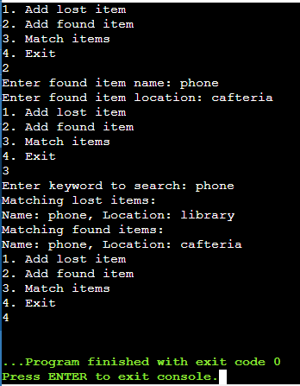
OUTPUT

Slide 16
TESTING AND VALIDATION
1. Verify that the program correctly adds lost and found items.
2. Verify that the program correctly matches items based on keywords.
3. Verify that the program handles invalid user input correctly.
Test Cases:
Test Case 1: Add Lost Item
- Input: Lost item name and location
- Expected Output: Lost item details stored in the array
VALIDATION
1. Verify that the program meets the requirements and specifications.
2. Test the program with different inputs and scenarios to ensure it works as expected.
3. Validate the output of the program to ensure it matches the expected results.

Slide 17
LIMITATIONS
1. Limited Data Storage
- The program uses arrays to store lost and found item details, which has a limited capacity.
- Once the array is full, no more items can be added.
2. Simple Search Functionality
- The program uses a basic string matching algorithm to search for keywords.
- It may not be effective for complex searches or partial matches.
3. No Data Validation
- The program does not validate user input for lost and found items.
FUTURE ENHANCEMENTS
4. User Authentication and Authorization
- Implement user authentication and authorization to restrict access to the program.
- This will improve the security and integrity of the data.
5. User-Friendly Interface
- Develop a more user-friendly interface, such as a graphical user interface (GUI).
- This will make the program more accessible and easier to use.

Slide 18
CONCLUSION
The Lost & Found Portal in C programming language is a simple yet effective solution for managing lost and found items. The program allows users to add lost and found items with their names and locations and match items based on keywords.
Key Takeaways:
- The program demonstrates the use of arrays and string manipulation in C.
- It provides a basic framework for managing lost and found items.
- The program can be further enhanced with additional features and functionality.
Future Scope:
The Lost & Found Portal can be further developed and improved by adding more features, such as:
- Dynamic data storage
- Advanced search functionality
- Data validation and sanitization
- User authentication and authorization
- User-friendly interface
Applications:
The Lost & Found Portal can be used in various settings, such as:
- Schools and universities
- Offices and workplaces
- Public places like parks and malls
- Transportation hubs like airports and train stations

Slide 19
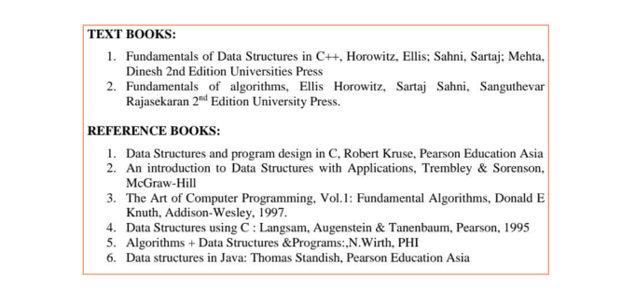
REFERENCES AND TEXTBOOKS

